Slide 1
Decision Trees
Decision Trees Algo by Shantanu Shubham

Slide 2
Example 1
Gender | Occupation | Suggestion
F | Student | PUBG
F | Programmer | GitHub
M | Programmer | WhatsApp
F | Programmer | GitHub
M | Student | PUBG
M | Student | PUBG

Slide 3
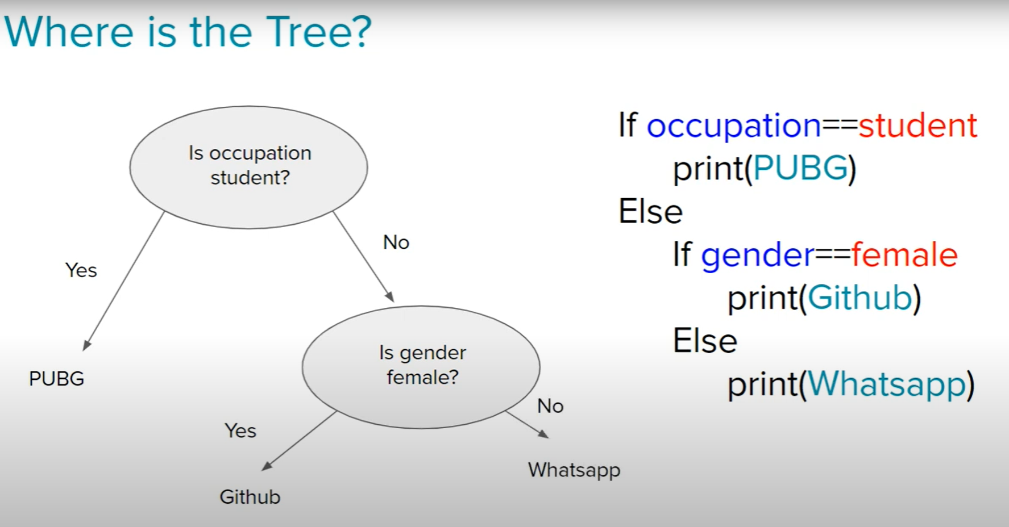

Slide 4
Example 2
Day | Outlook | Temp | Humidity | Wind | PlayTennis
D1 | Sunny | Hot | High | Weak | No
D2 | Sunny | Hot | High | Strong | No
D3 | Overcast | Hot | High | Weak | Yes
D4 | Rain | Mild | High | Weak | Yes
D5 | Rain | Cool | Normal | Weak | Yes
D6 | Rain | Cool | Normal | Strong | No
D7 | Overcast | Cool | Normal | Strong | Yes
D8 | Sunny | Mild | High | Weak | No
D9 | Sunny | Cool | Normal | Weak | Yes
D10 | Rain | Mild | Normal | Weak | Yes
D11 | Sunny | Mild | Normal | Strong | Yes
D12 | Overcast | Mild | High | Strong | Yes
D13 | Overcast | Hot | Normal | Weak | Yes
D14 | Rain | Mild | High | Strong | No

Slide 5
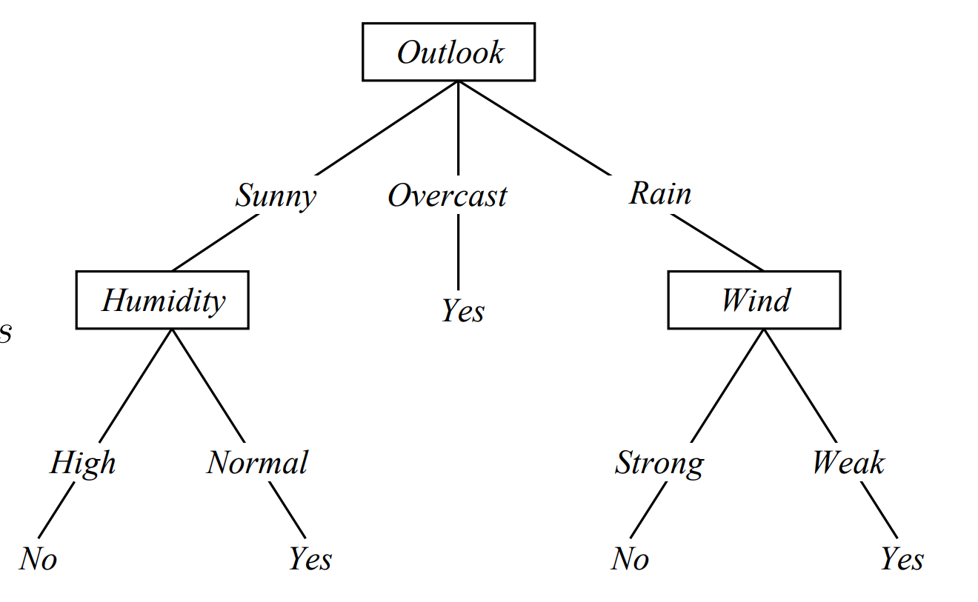
Input (Rainy, Mild, High, Strong)

Slide 6
What if we have Numerical Data?
Petal Length | Sepal Length | Type
1.34 | 0.34 | Setosa
3.45 | 1.45 | Versicolor
1.69 | 0.98 | Setosa
2.56 | 1.79 | Virginica
3.00 | 1.13 | Versicolor
1.3 | 0.88 | Setosa
PL< 2.0
Yes
No
Setosa
SL < 1.5
Yes
No
Versicolor
Virginica

Slide 7
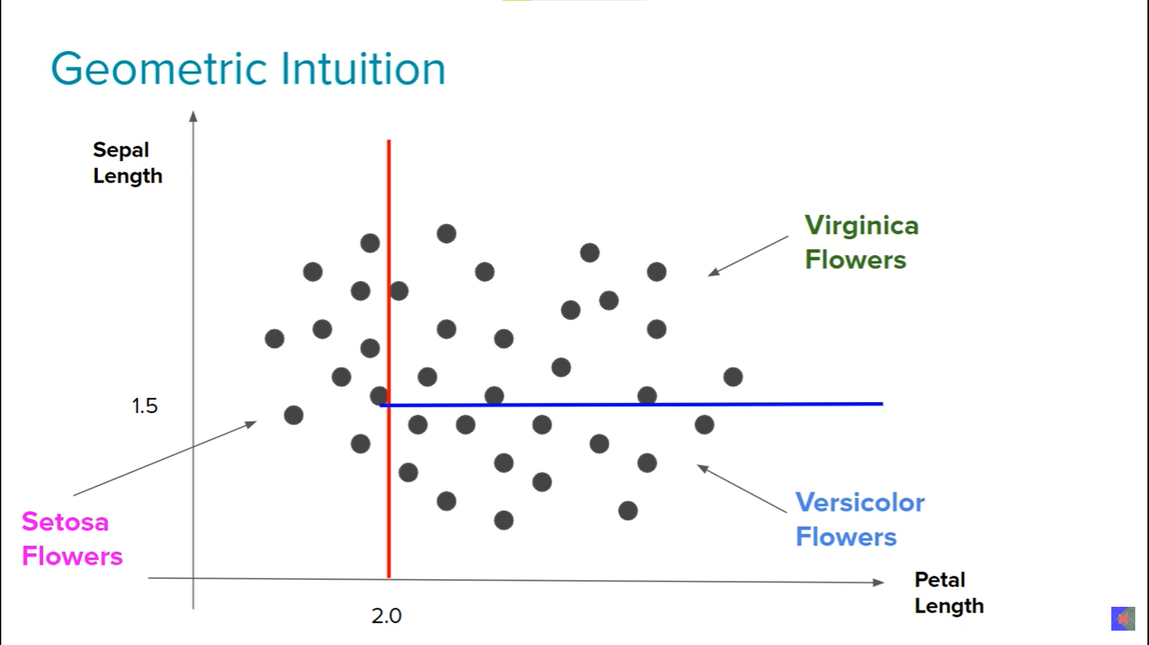

Slide 8
Pseudo Code
Begin with your training dataset, which should have some feature variables and classification or regression output.
Determine the best feature in the data set to split the data on; more on how we define best feature later.
Split the data into subsets that contain the correct values for this best feature. The splitting basically defines a node on the tree i.e. each node is a splitting point based on a certain feature from our data.
Recursively generate new tree nodes by using the subset of data created from step 3.

Slide 9
Conclusion
Programmatically speaking, decision trees are nothing but a giant structure of nested if else conditions.
Mathematically speaking, decision trees use hyperplanes which run parallel to any one of the axed to cut your coordinate system into hyper cuboids.

Slide 10
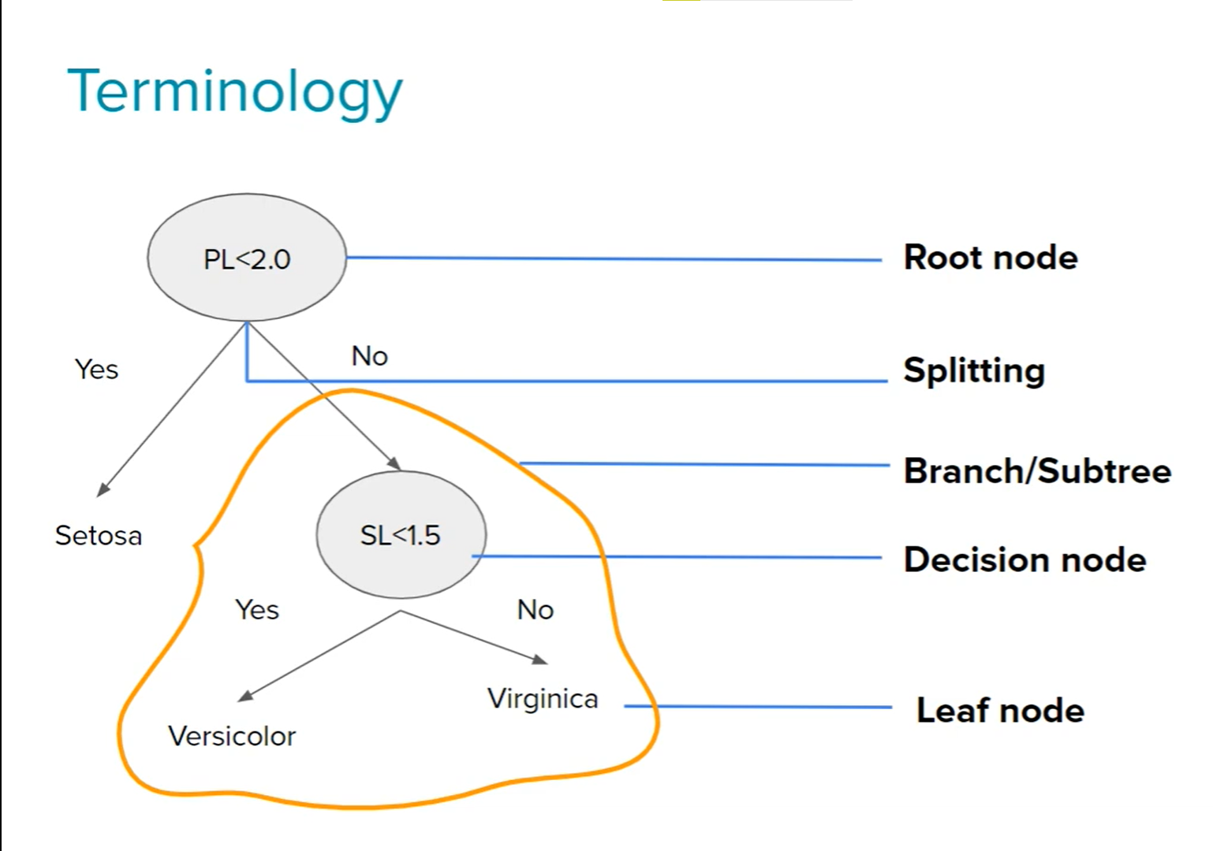

Slide 11
Advantages and Disadvantages
Advantages
Disadvantages
Intuitive and easy to understand
Minimal data preparation is required.
The cost of using the tree for inference is logarithmic in the number of data points used to train the tree.
Overfitting
Prone to errors for imbalanced datasets.

Slide 12
AKINATOR
https://en.akinator.com/

Slide 13
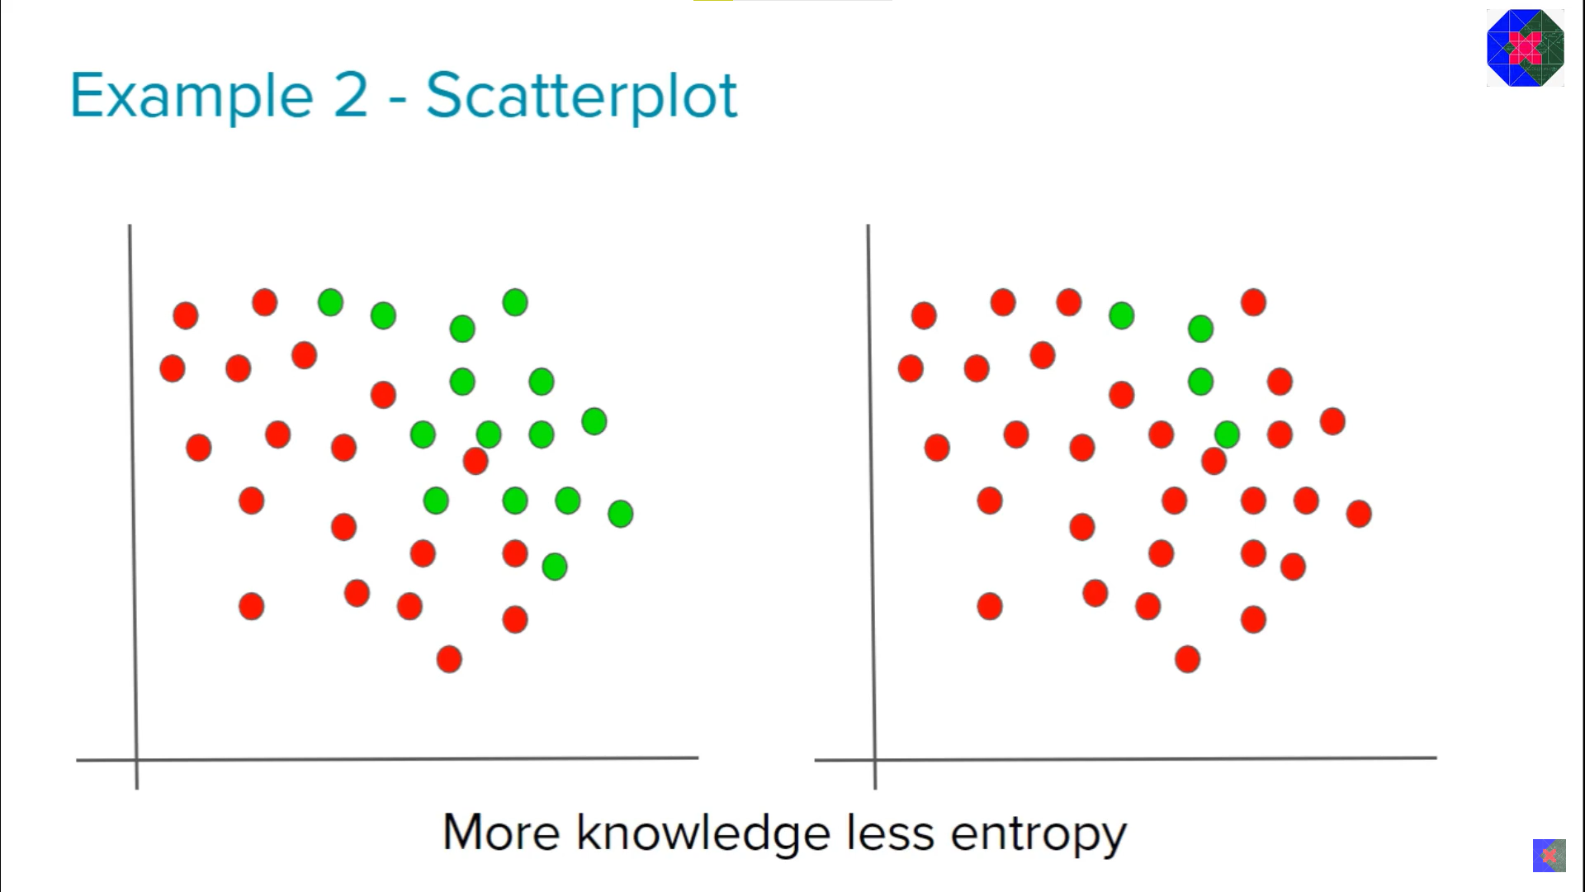
Entropy
Measurement of randomness or disorder.

Slide 14

How to calculate Entropy?
The mathematical formula is: $E\left(S\right)= \sum_{i=1}^{c}{{−p}_{i}\log_{2}{(p}_{i})}$
$$Where, pi is simply the frequentist probability of an element or class{{}_{}^{′}i}^{′} in our data$$
$$E\left(D\right)={−p}_{yes}\log_{2}{(p}_{yes})+ {−p}_{no}\log_{2}{(p}_{no})$$

Slide 15
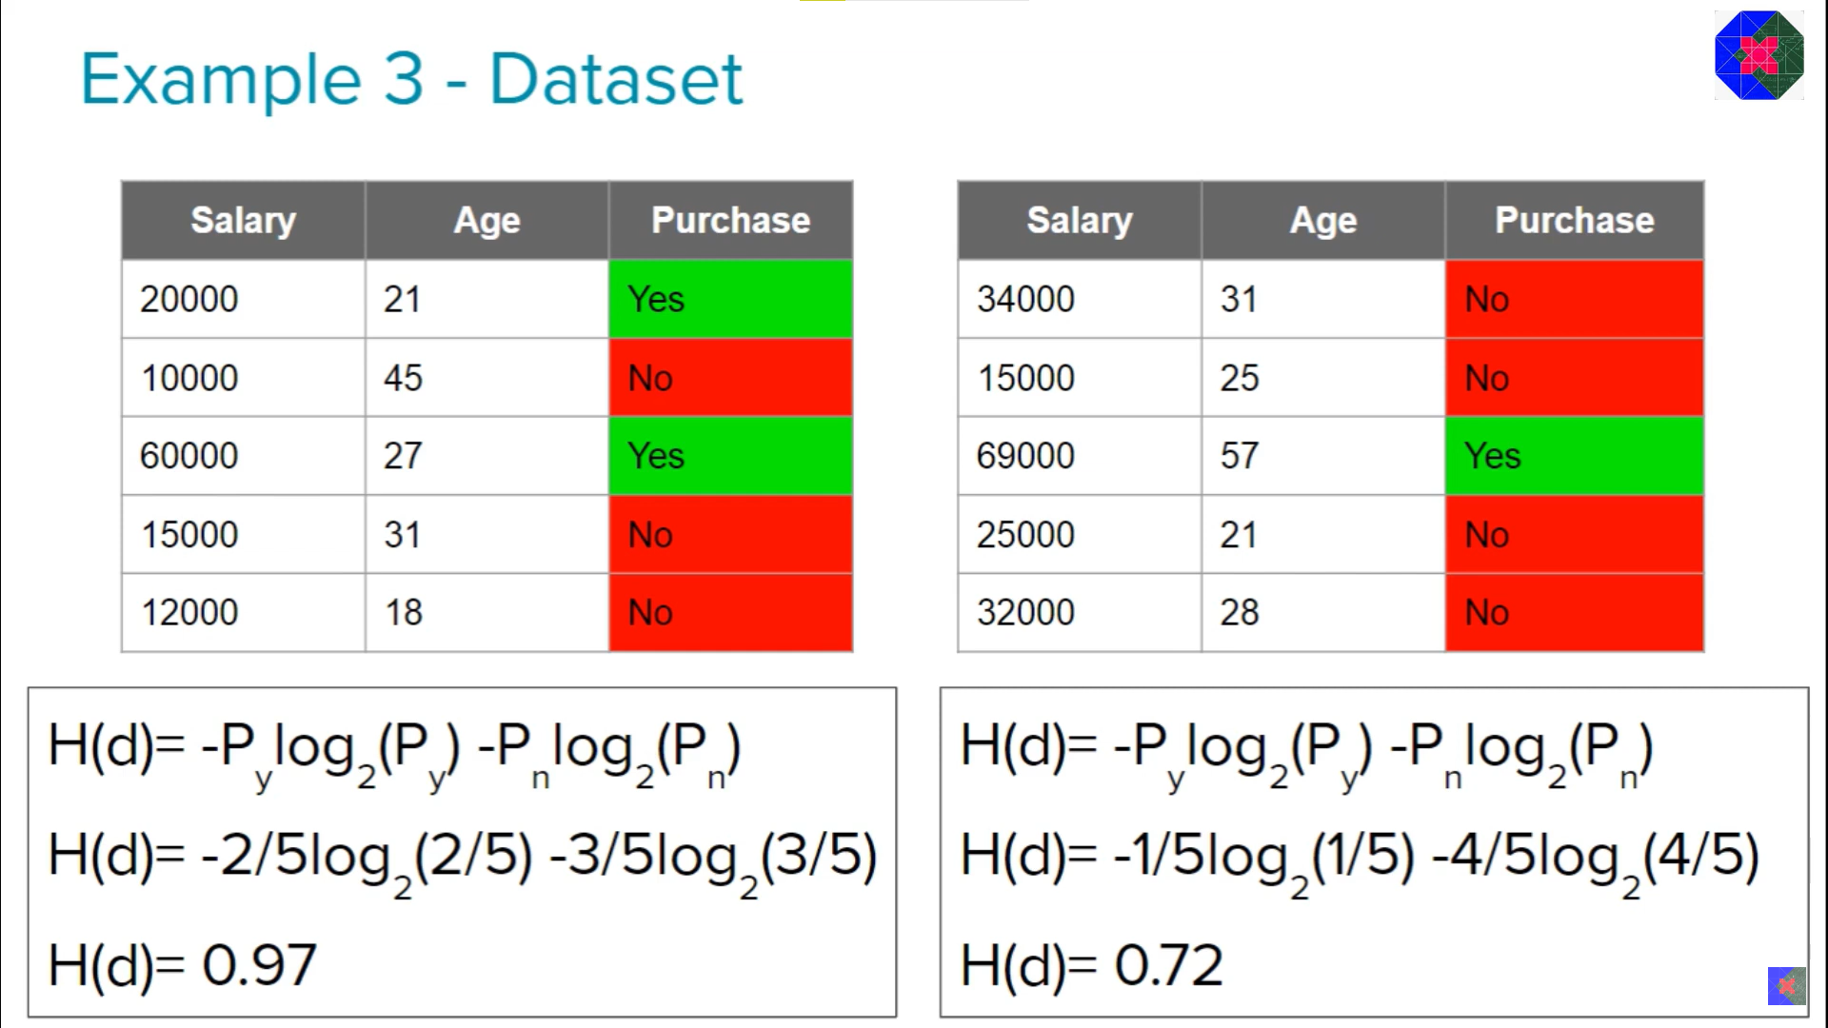

Slide 16
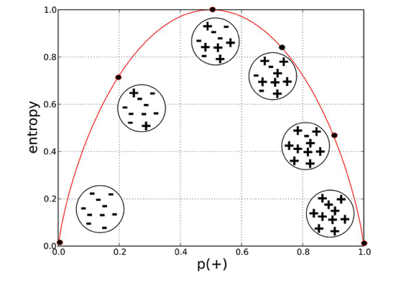
Observation
More the uncertainty, more is entropy
For a 2 class problem, the minimum entropy is 0 and the max is 1.
For more than 2 classes, the minimum entropy is 0 but the maximum can be greater than 1.
Both log base 2 or ln can be used to calculate entropy.

Slide 17
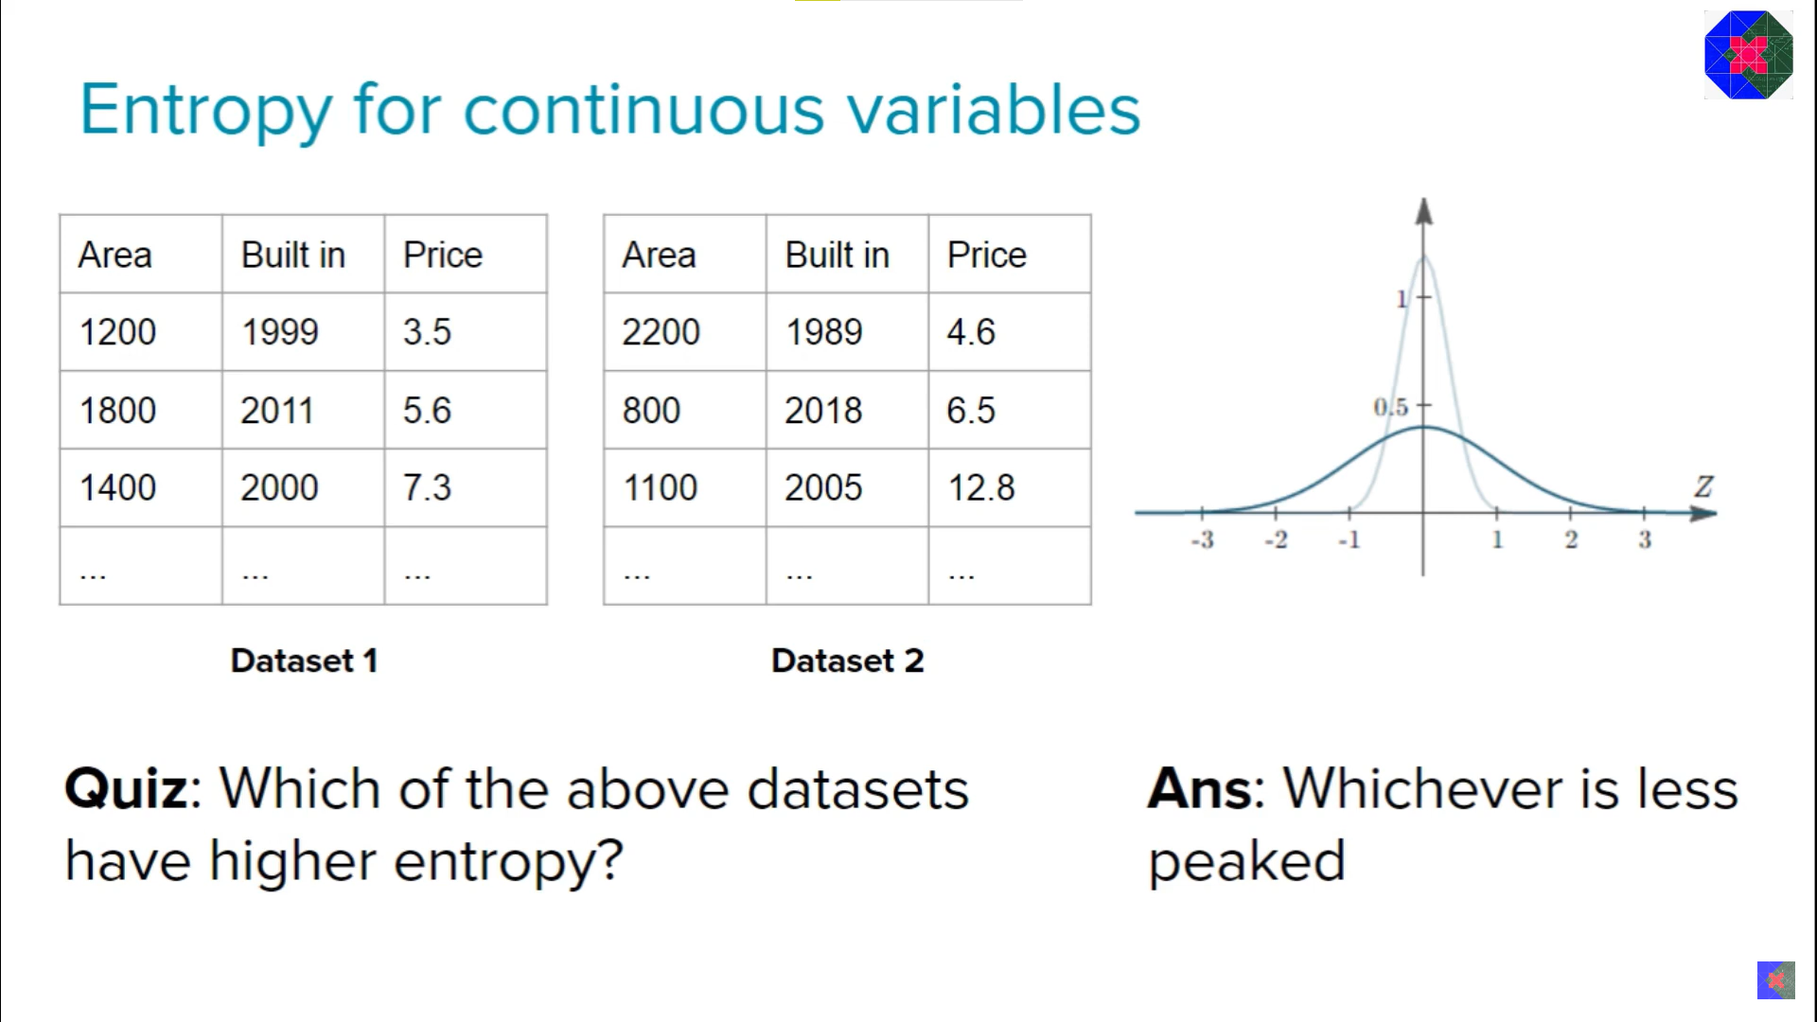

Slide 18
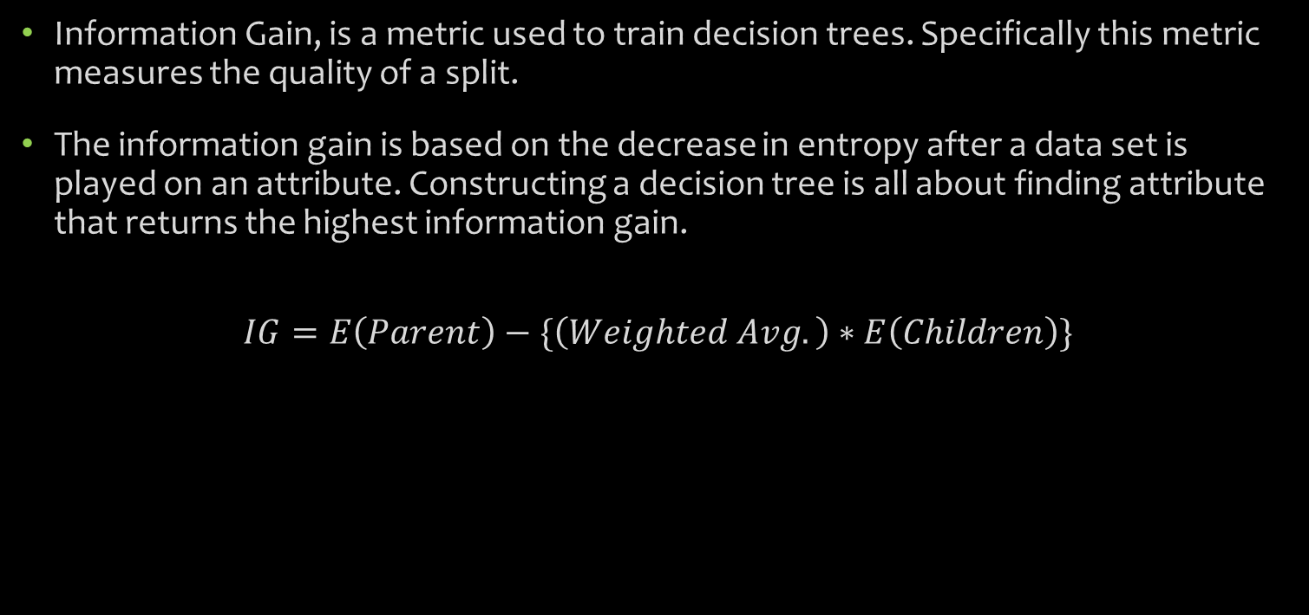
Information Gain (IG)
Information Gain, is a metric used to train decision trees. Specifically this metric measures the quality of a split.
The information gain is based on the decrease in entropy after a data set is played on an attribute. Constructing a decision tree is all about finding attribute that returns the highest information gain.
$$IG=E\left(Parent\right)−\{\left(Weighted Avg.\right)∗E\left(Children\right)\}$$

Slide 19
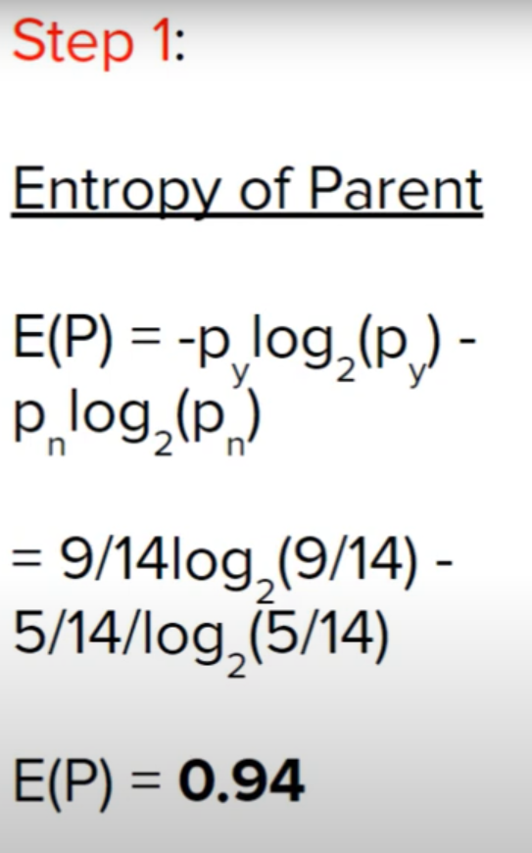
Day | Outlook | Temp | Humidity | Wind | Play Tennis
D1 | Sunny | Hot | High | Weak | No
D2 | Sunny | Hot | High | Strong | No
D3 | Overcast | Hot | High | Weak | Yes
D4 | Rain | Mild | High | Weak | Yes
D5 | Rain | Cool | Normal | Weak | Yes
D6 | Rain | Cool | Normal | Strong | No
D7 | Overcast | Cool | Normal | Strong | Yes
D8 | Sunny | Mild | High | Weak | No
D9 | Sunny | Cool | Normal | Weak | Yes
D10 | Rain | Mild | Normal | Weak | Yes
D11 | Sunny | Mild | Normal | Strong | Yes
D12 | Overcast | Mild | High | Strong | Yes
D13 | Overcast | Hot | Normal | Weak | Yes
D14 | Rain | Mild | High | Strong | No

Slide 20
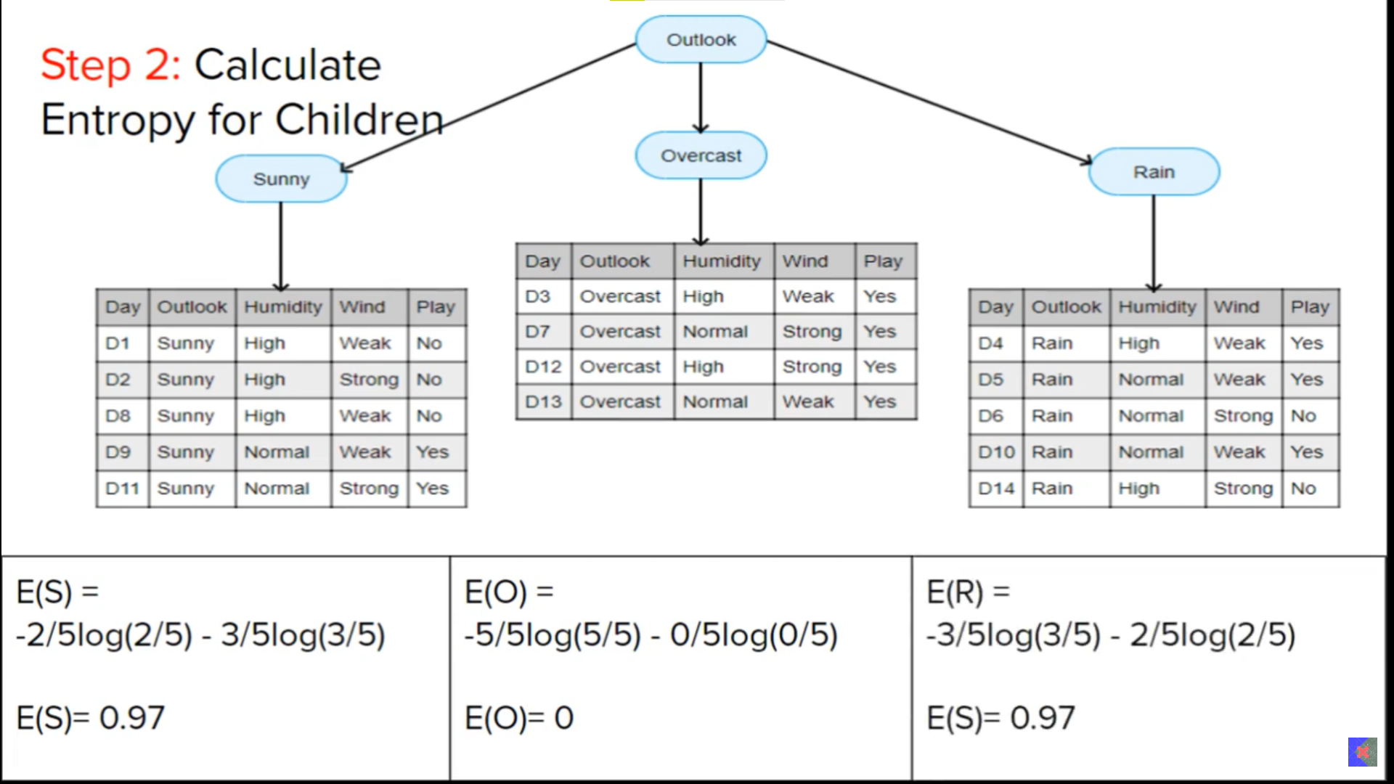

Slide 21
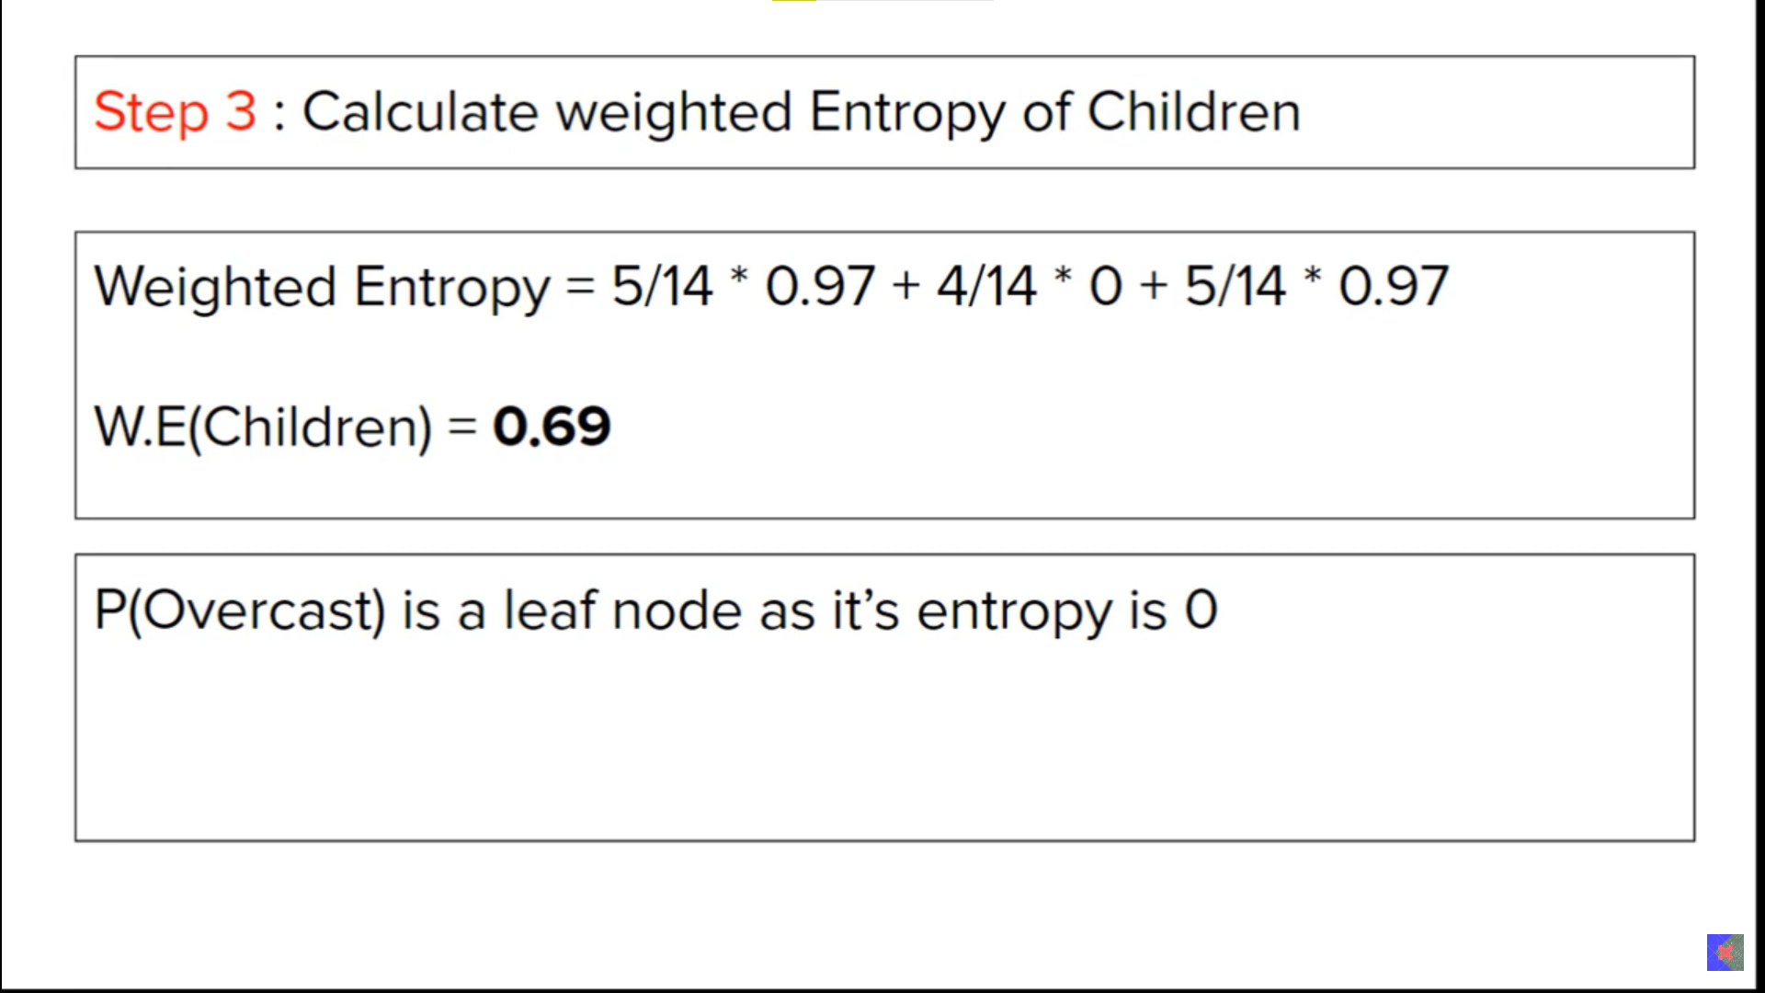

Slide 22
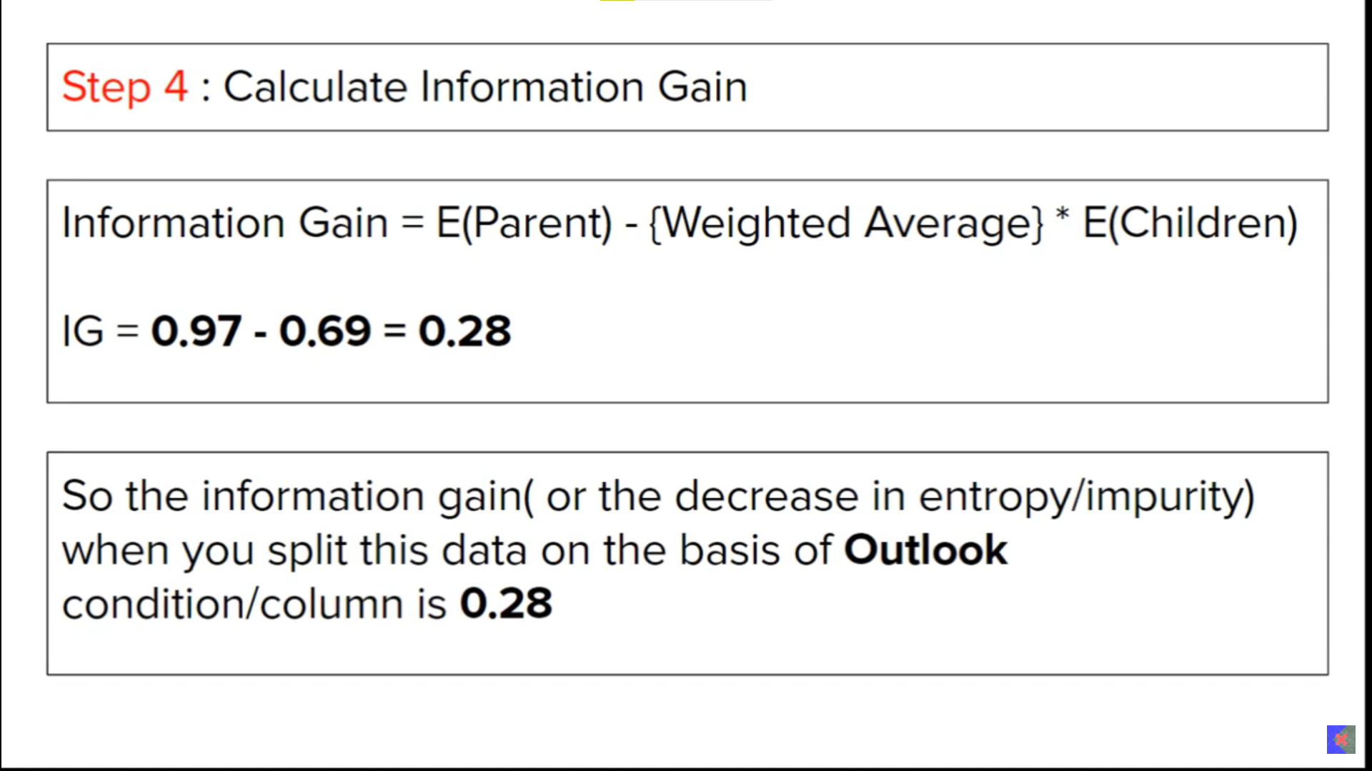

Slide 23
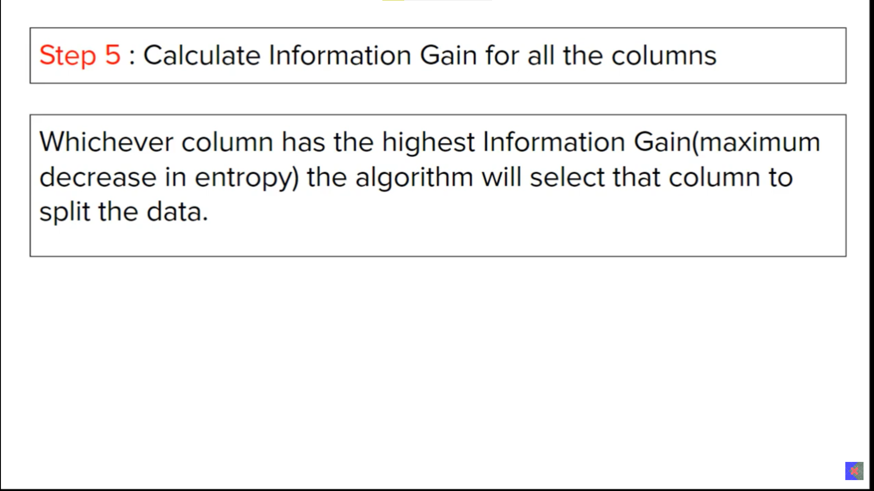

Slide 24
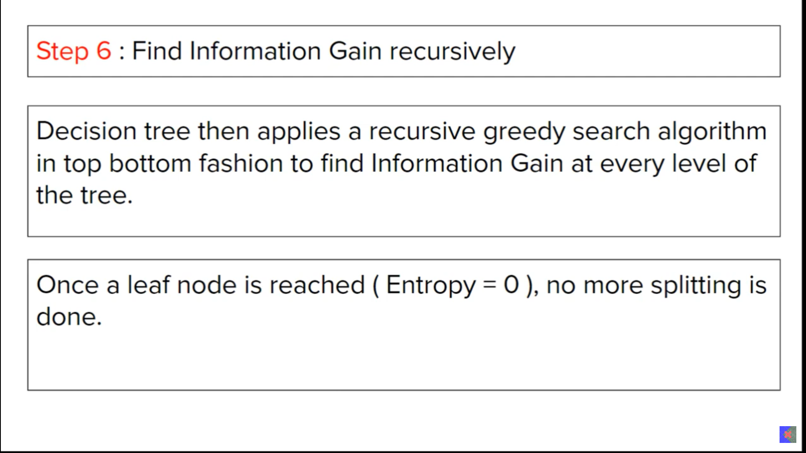

Slide 25
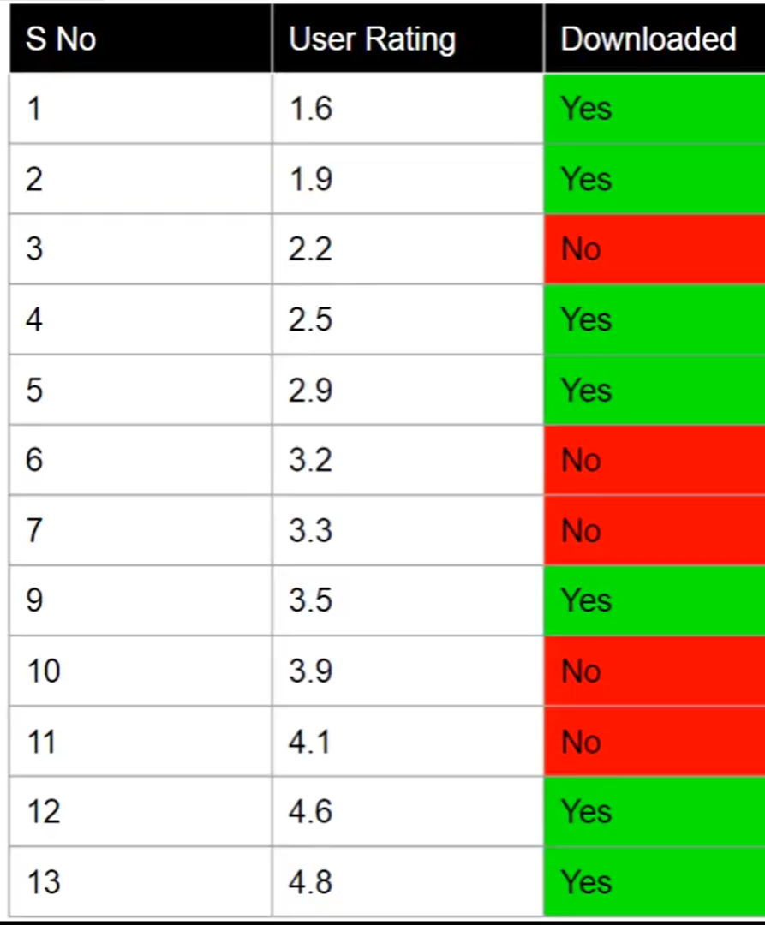
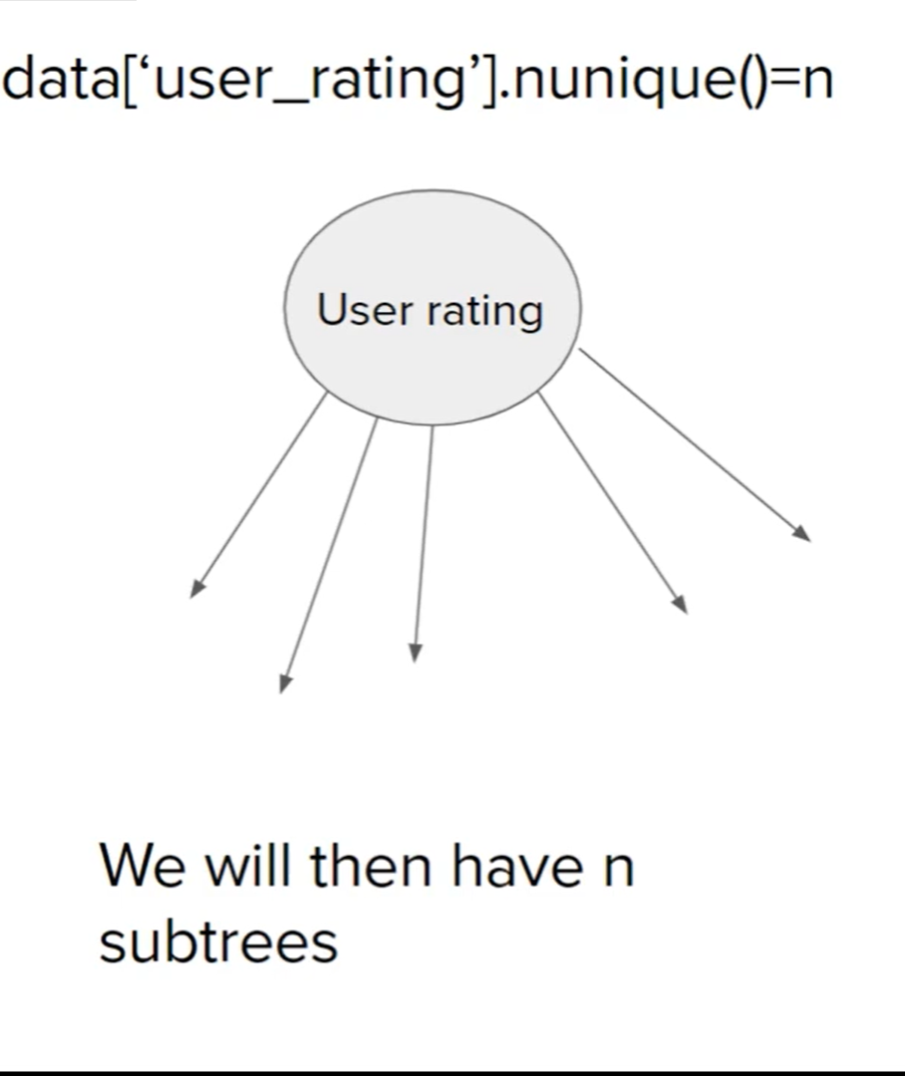
Handling Numerical Data

Slide 26
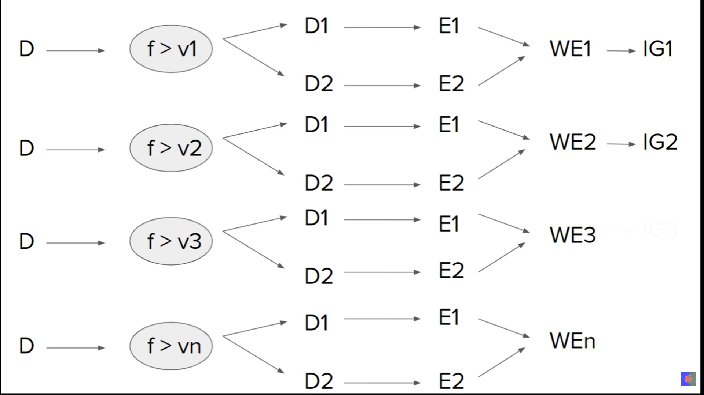

Slide 27
